Slide 1
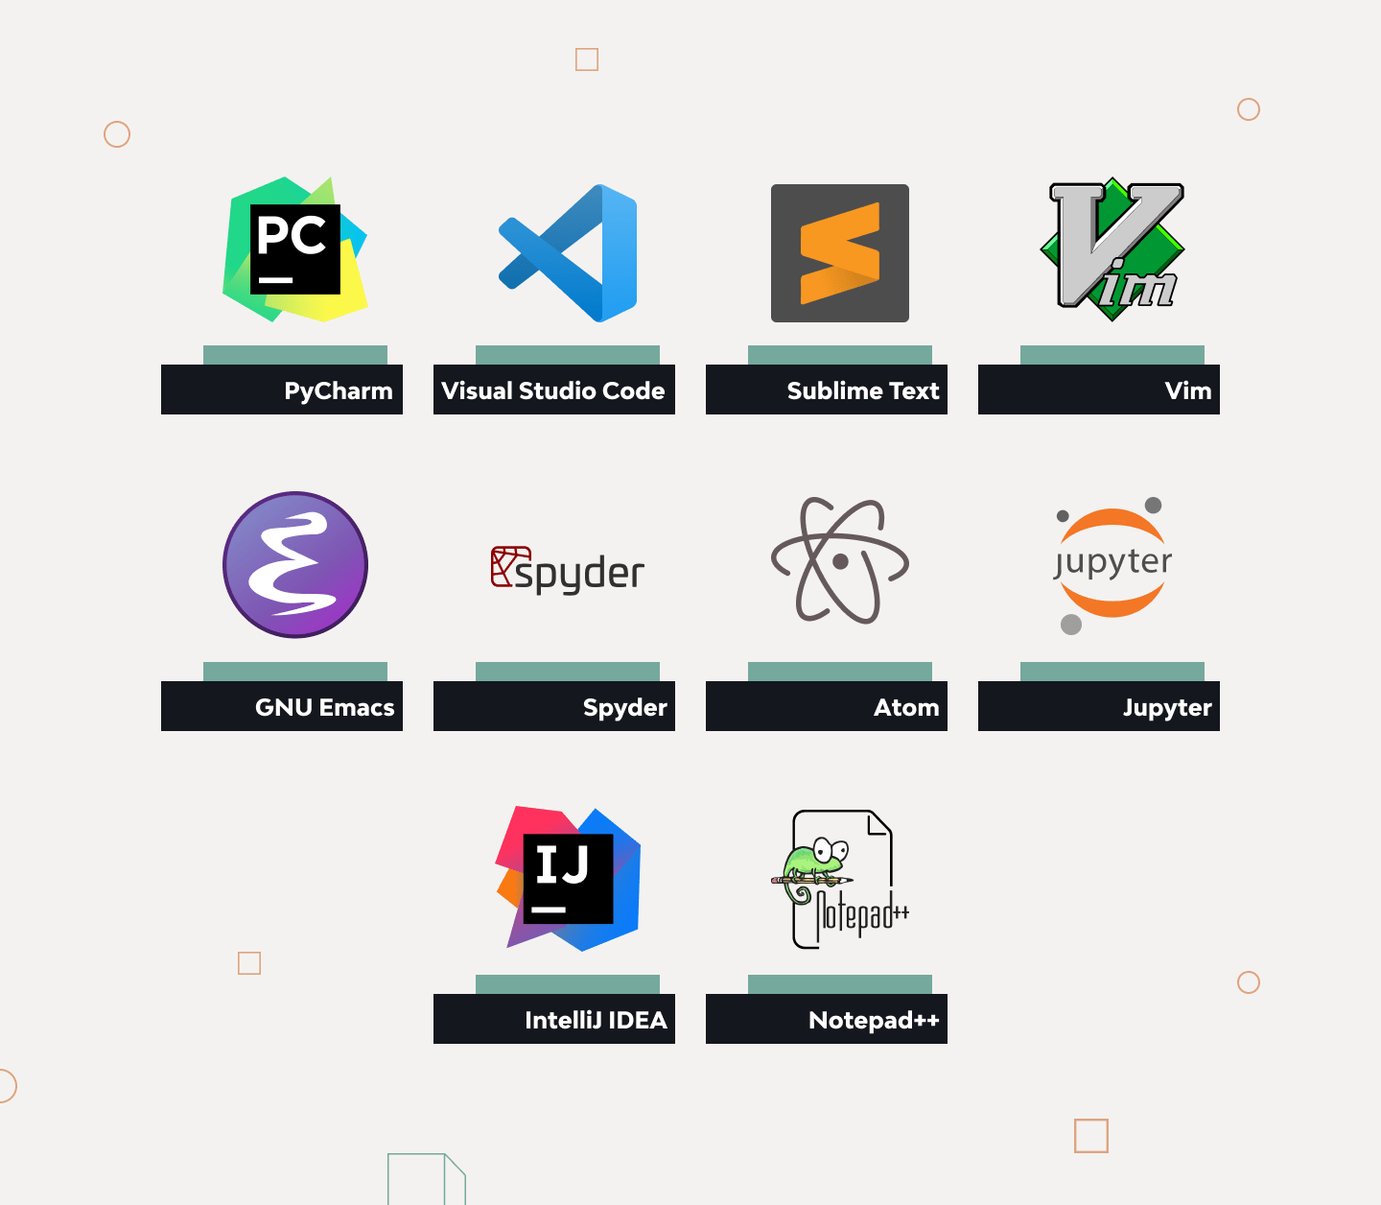
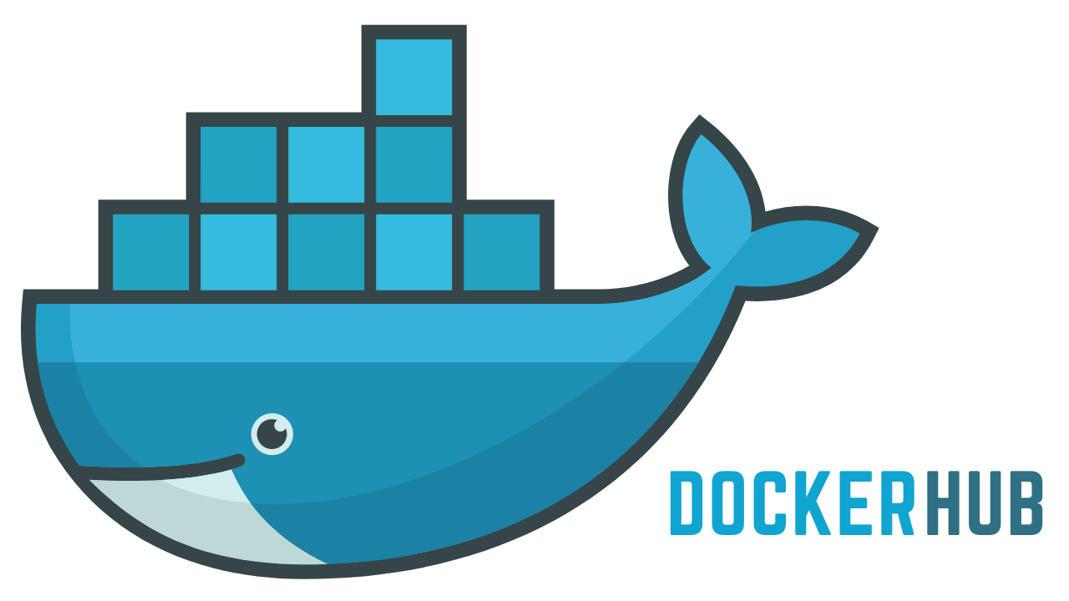
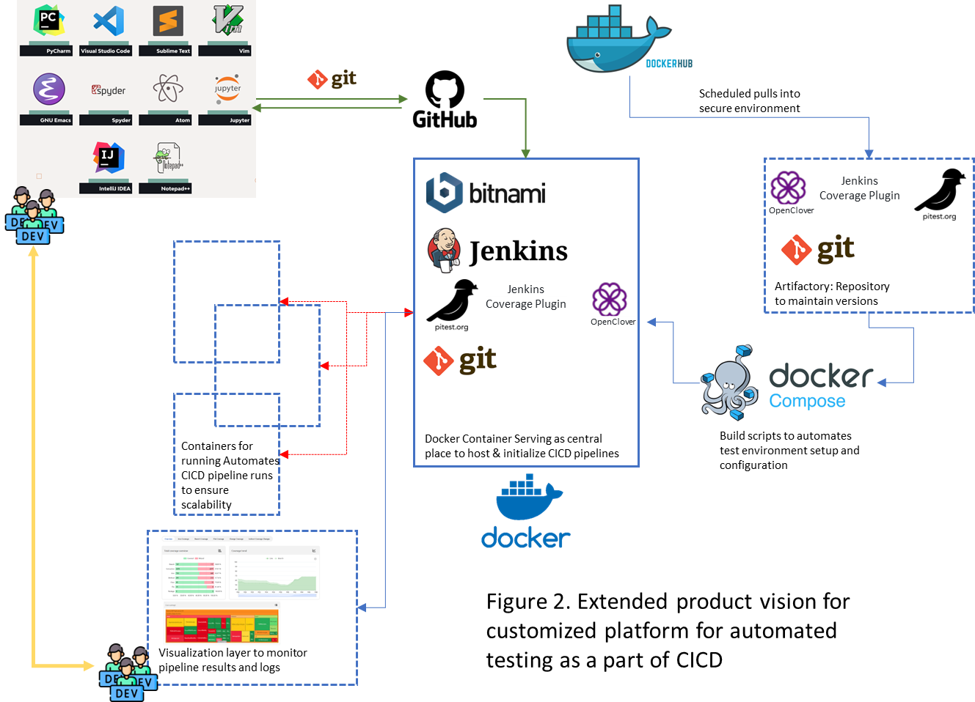








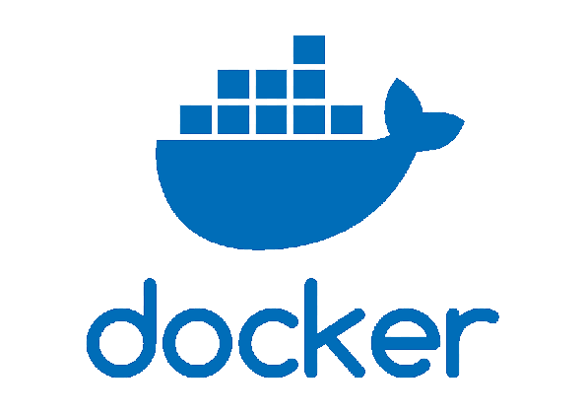
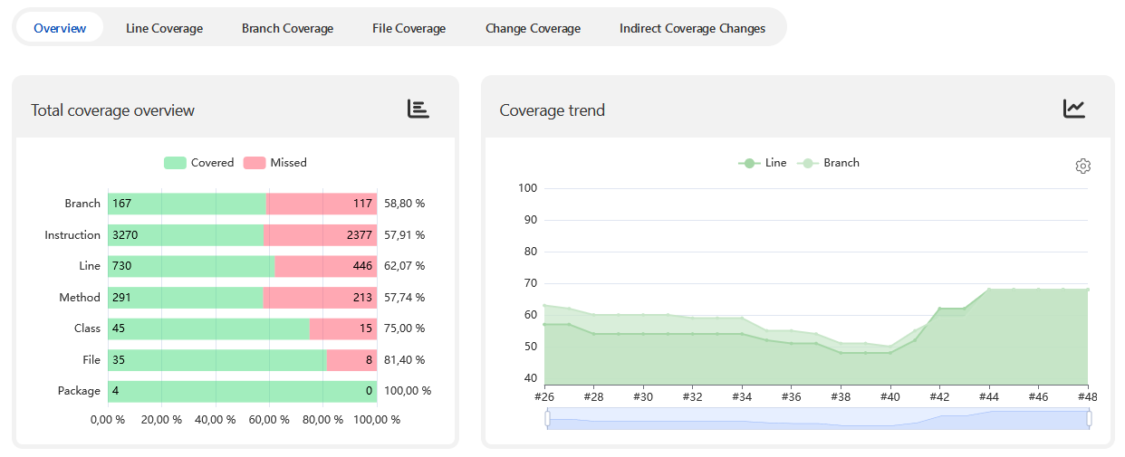
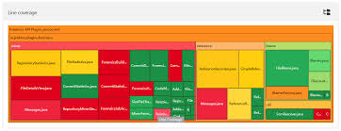
Scheduled pulls into secure environment
Jenkins Coverage Plugin
OpenClover
Jenkins Coverage Plugin
Artifactory: Repository to maintain versions
OpenClover
Containers for running Automates CICD pipeline runs to ensure scalability
Docker Container Serving as central place to host & initialize CICD pipelines
Build scripts to automates test environment setup and configuration
Figure 2. Extended product vision for customized platform for automated testing as a part of CICD
Visualization layer to monitor pipeline results and logs

Slide 2
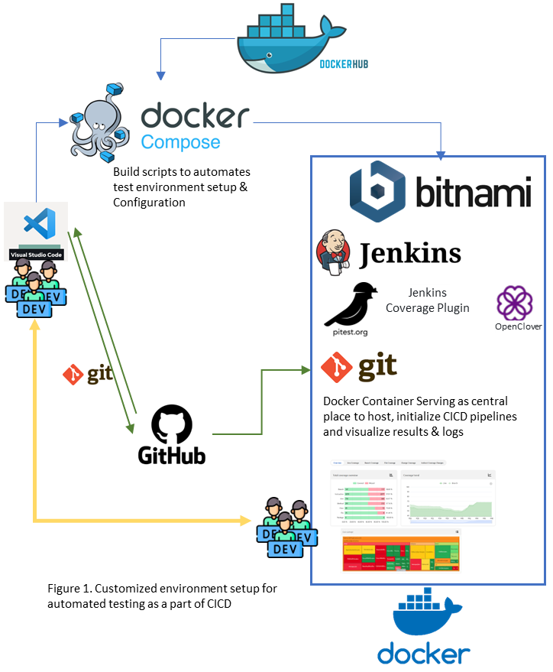
Build scripts to automates test environment setup & Configuration
Jenkins Coverage Plugin
OpenClover
Docker Container Serving as central place to host, initialize CICD pipelines and visualize results & logs
Figure 1. Customized environment setup for automated testing as a part of CICD

Slide 3
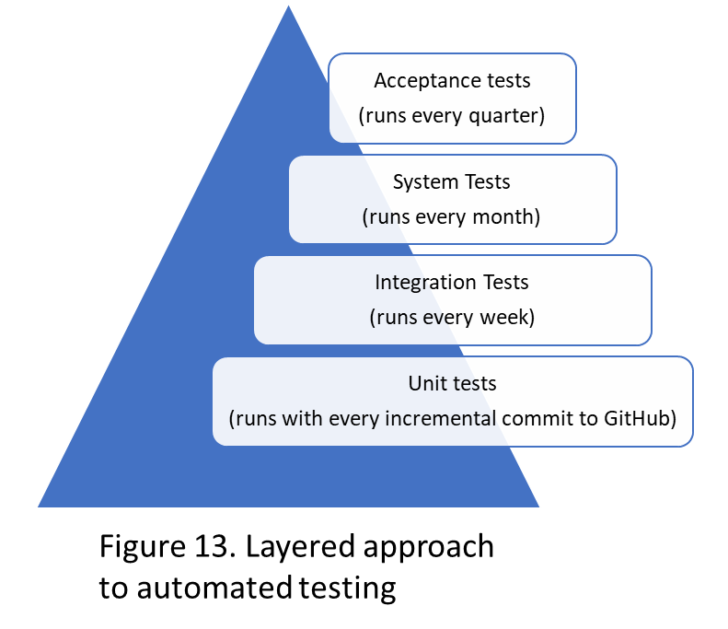
Acceptance tests
(runs every quarter)
Integration Tests
(runs every week)
Unit tests
(runs with every incremental commit to GitHub)
System Tests
(runs every month)
Figure 13. Layered approach to automated testing

